Slide 1
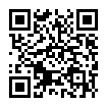
Extracting data from PDFs

Slide 2
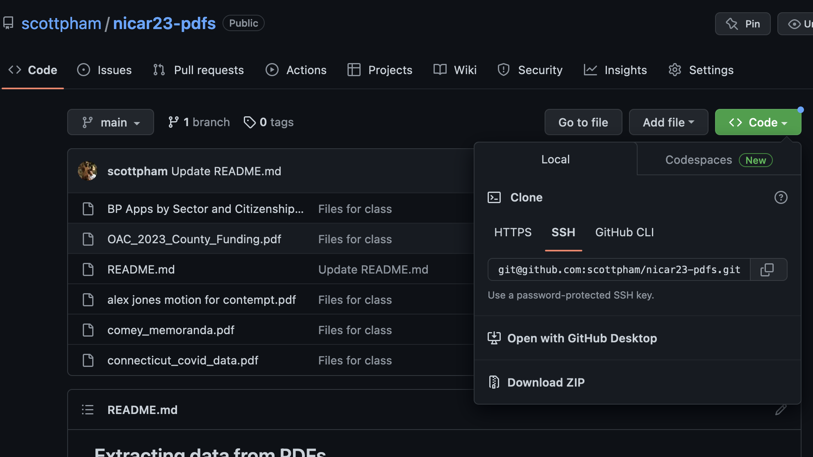
Download files

Slide 3
Who am I
Data reporter, formerly at BuzzFeed News
Teach at the City College of New York (CUNY)
I’ve worked on both solo investigations and large collaborations like the FinCEN Files
I do data analysis in Python/Pandas but started with a lot of tools you’re seeing today

Slide 4
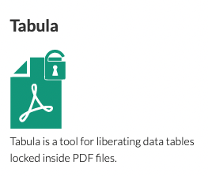
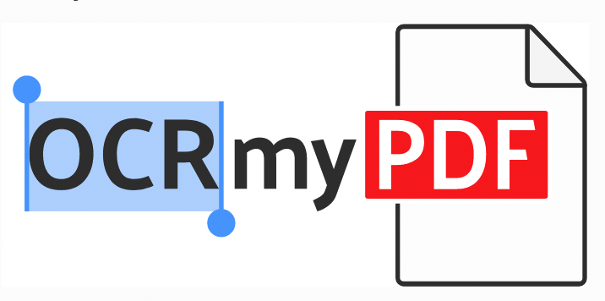
What tools we’re using
Tabula - a free and open-source downloadable app for extracting tables
Ocrmypdf - a free and open-source command-line application for optical character recognition

Slide 5
What tools we’re using
Tabula - a free and open-source downloadable app for extracting tables
Ocrmypdf - a free and open-source command-line application for optical character recognition
D/L instructions here!

Slide 6
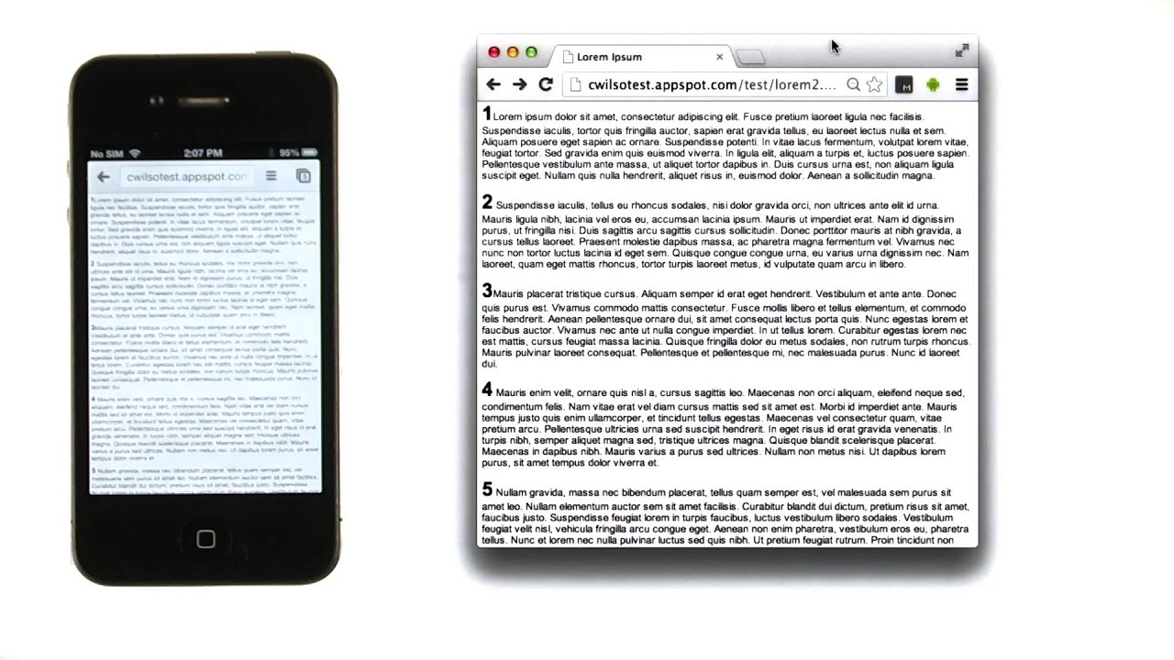
Why is this so damn hard?
PDFs are for seeing not for reading
Designed to look the same everywhere

Slide 7
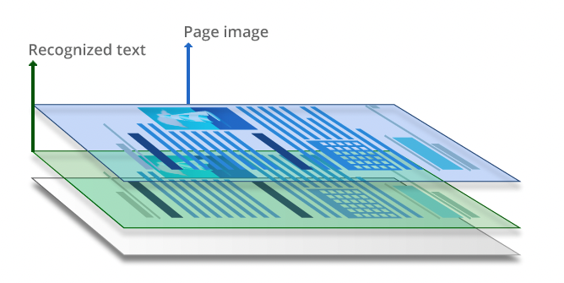
The two types of PDFs
“Computer-generated PDFs”
Usually converted from a text document like Microsoft Word
“Image-only” PDFs
Usually a digitally scanned version of print documents.
OCR’d PDFs
Image-only PDFs that have been “augmented” with a searchable text layer
Notes:
Not really official names, but the way I think of it. Searching online shows that “True PDF” is a common term. The “PDF Association” (such a thing exists!) calls them “born digital” PDFs.

Slide 8
But…why?
Some reasons why you might make an image-only PDF:
Convenience/laziness
Fear of manipulation
Fear of redaction mistakes
Actual malice
Notes:
From Steve Doig: “One of the biggest problems in database work is that often you will be using for analysis reasons data that has been gathered for bureaucratic reasons. The problem is that the standard of accuracy for those two is quite different.”

Slide 9
When to extract data from PDFs
Only when you must.
Downsides:
Accuracy is hit-or-miss and potentially hard to fact check
Sometimes it can take you longer than the alternatives
Notes:
It’s very hard to visually check a large amount of numbers

Slide 10
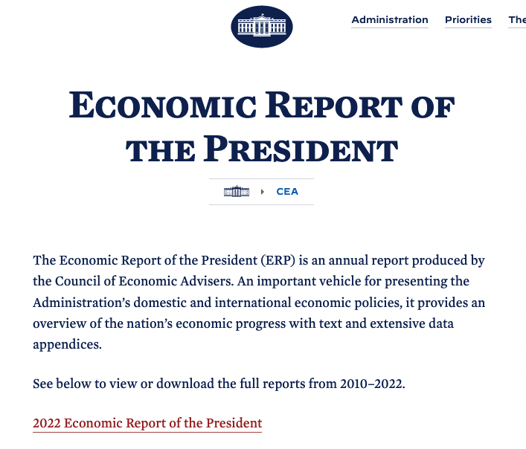
Example
Economic Report of the President
First google link:

Slide 11
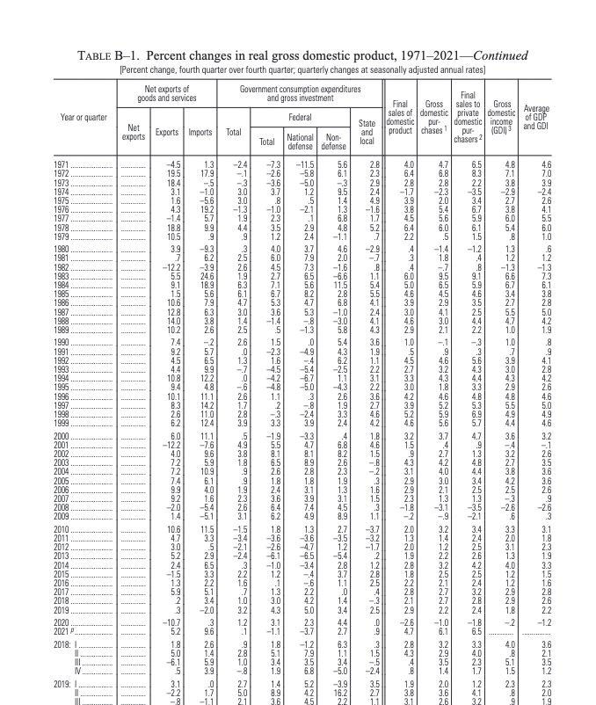
Example
A 400 + page PDF.
Searchable, but filled with data tables.

Slide 12
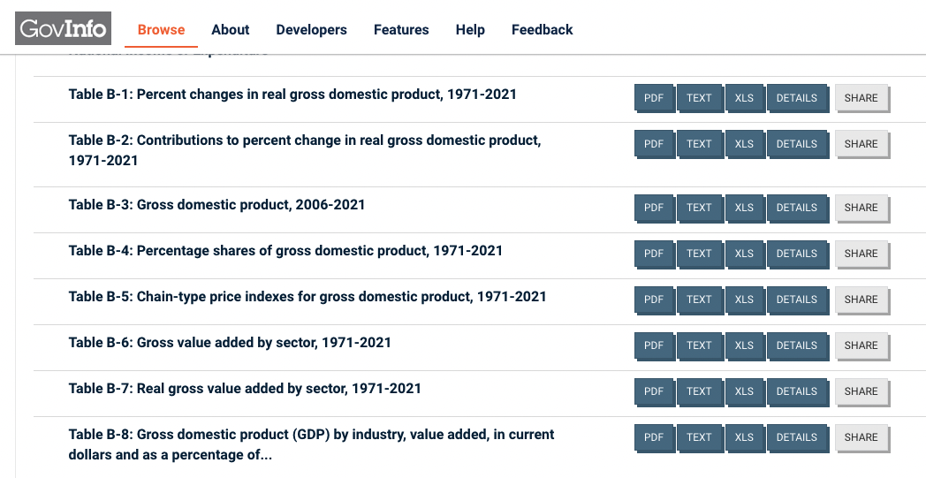
Example
Second google link:
GovInfo site with XLS files for every table
Notes:
Won’t always be this easy, but don’t be surprised if there exists a more usable file of the same document from a different source.
For academic papers, try reaching out directly to the authors

Slide 13
Working with computer-generated-PDFs
Tabula
Drag and drop sites - easy, but may require payment
CleverPDF
PDF to Excel
Code
Pdfplumber
Tabula-py
Notes:
Code is especially useful when you need to a complex file, many versions of the same file, or if you expect to scrape as similar file again (code reuse)

Slide 14
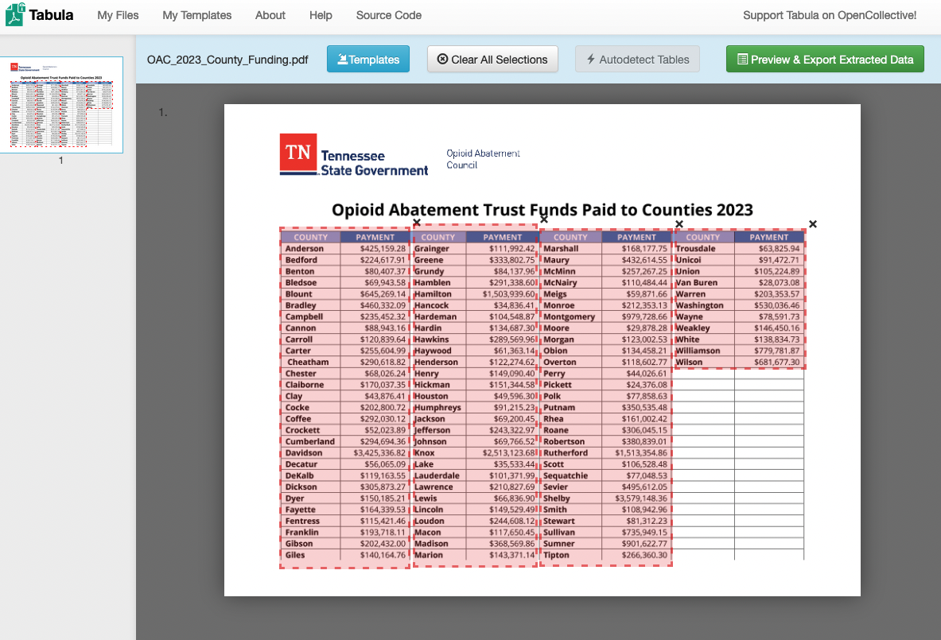
Hands-on: Working with Tabula

Slide 15
OCR
(Optical Character Recognition)
Commonly needed with court documents, older documents
Easier with text-only or text-mostly documents
Tabular data is troublesome
Images, handwriting, and redaction can mess you up
Some algorithms are better than others

Slide 16
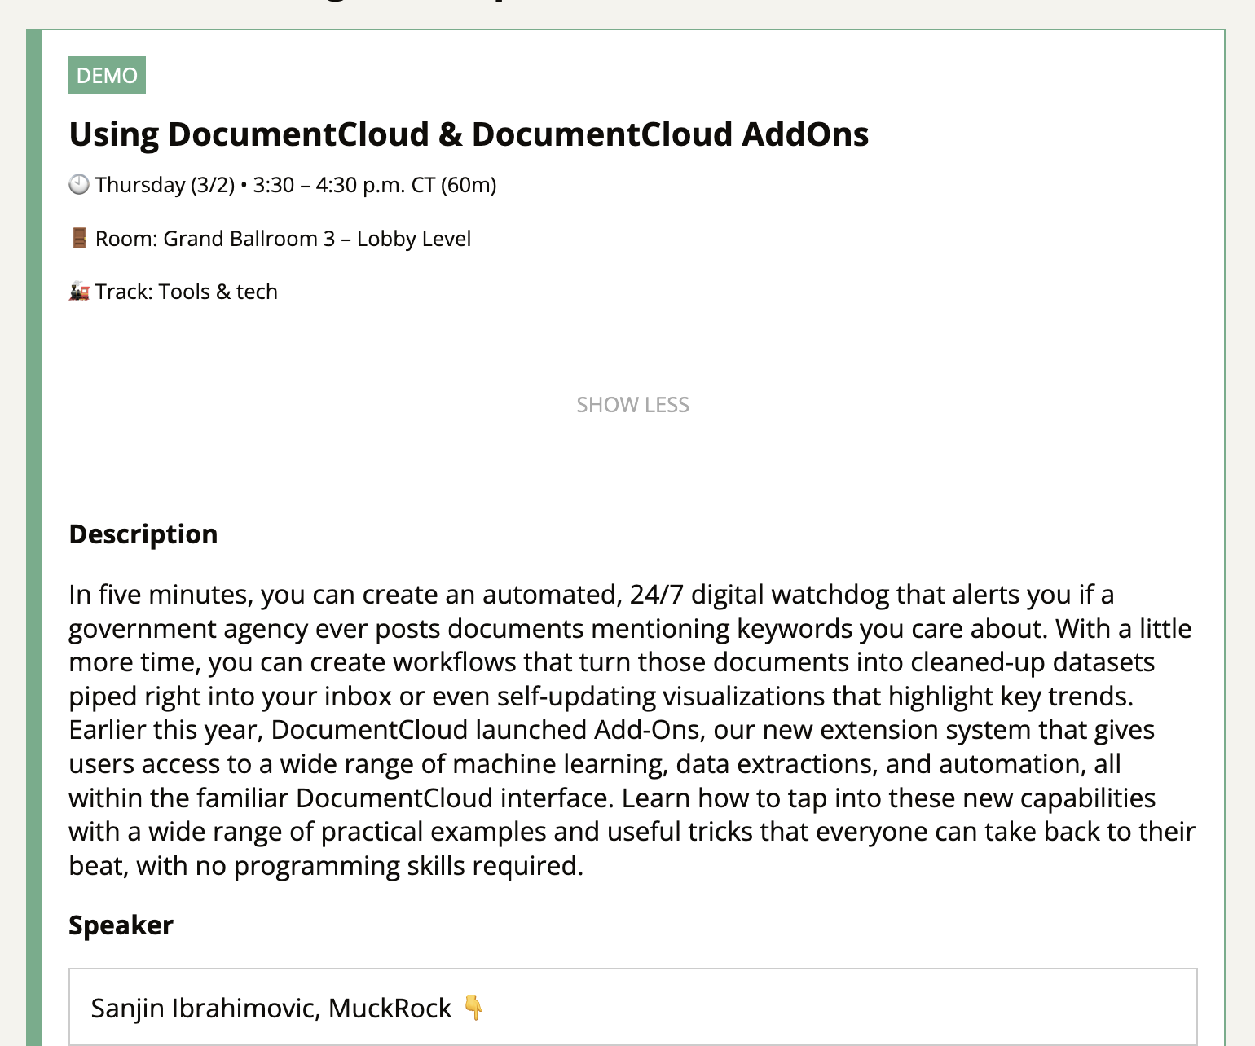
OCR
Your options:
DocumentCloud
Google PinPoint
Adobe Acrobat Pro
Short guide
Code
pytesseract
Command-line utilities
OCRmyPDF
Notes:
Adobe Acrobat (not reader!) is expensive, but including because you may already have access through your workplace

Slide 17
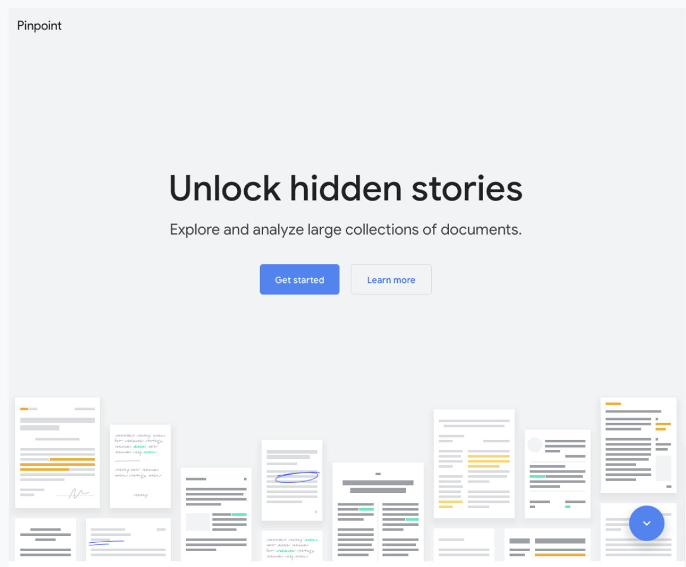
Google Pinpoint
Part of Google’s “Journalist Studio”
Experimental structured data scraping in beta
Notes:
Sign up: https://support.google.com/pinpoint/answer/13012346?hl=en&ref_topic=11948319

Slide 18
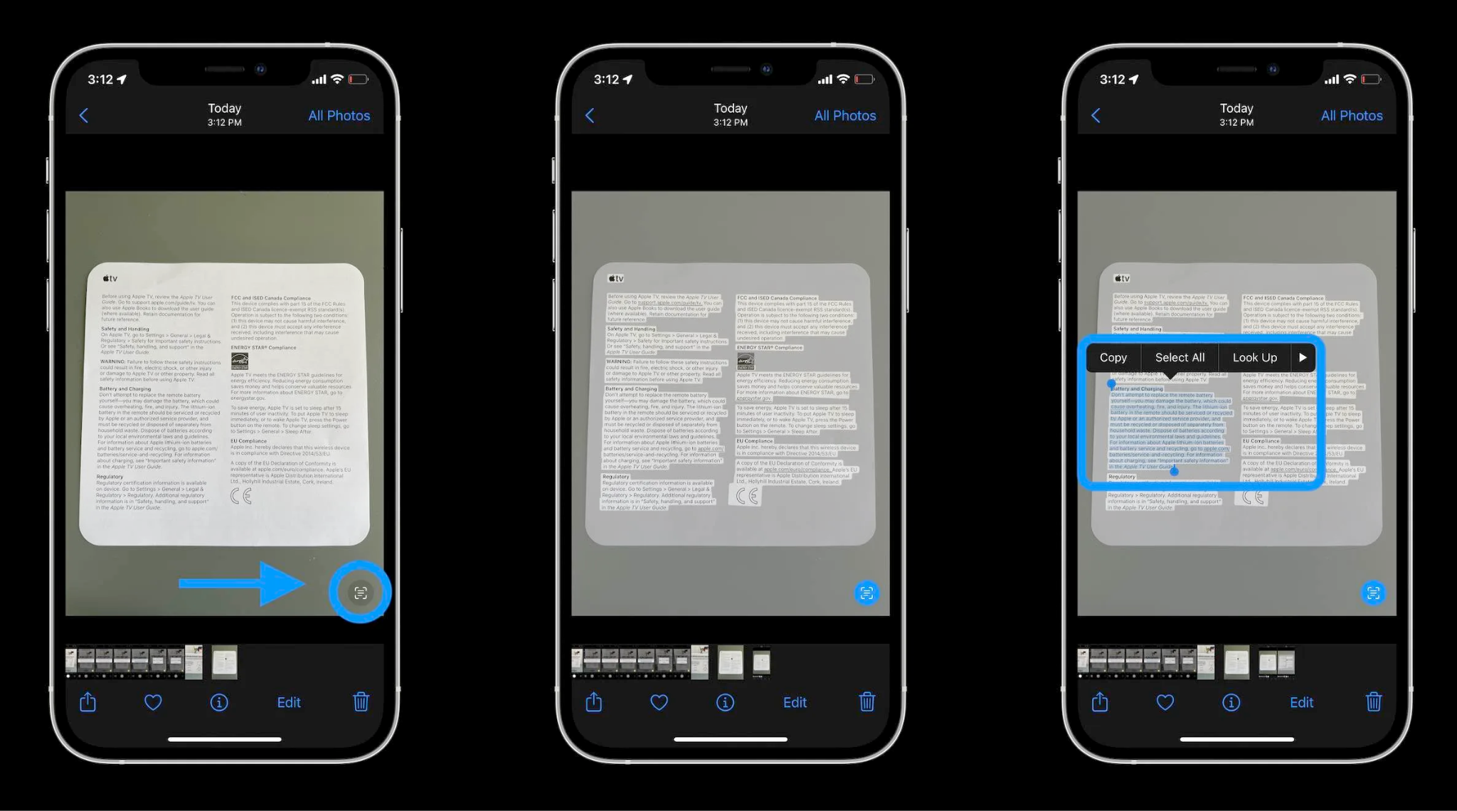
Your phone (seriously)
iPhone photos app, notes app
Requires iPhone Xs or later (2018+)
Android: People seem to like “Text Fairy”
Notes:
Fast, but hard to do multiple pages with
Good for casual use - perhaps you want to email some text to someone, or need to google search a long paragraph or something
Would not be my go-to for most things, but good to know it’s available

Slide 19
When to use a command-line activity
Your files are big
You need it fast
You need a little more flexibility than the GUI tools
Notes:
Many pages or many gigabytes, command line is easier

Slide 20
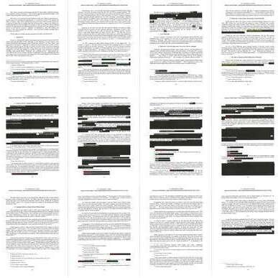
Example
The Mueller Report:
More than 400 pages
Intense competition to publish upon release
Completely unsearchable
Embarrassment to the “PDF Association”

Slide 21
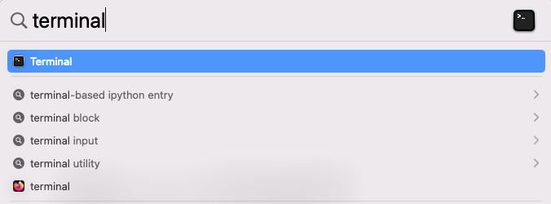
Hands-on: OCRmyPDF
Download the PDF: comey_memoranda.pdf from the Github repo
Move it to your computer’s Desktop
Open up your terminal
Mac users: Cmd + SPACE will open spotlight. Then just type “terminal” and hit Enter

Slide 22
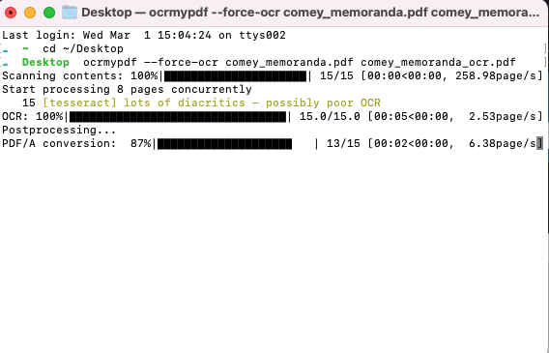
Hands-on: OCRmyPDF
cd ~/Desktop
ocrmypdf --force-ocr comey_memoranda.pdf comey_memoranda_ocr.pdf
Notes:
Open terminal

Slide 23
Hands-on: OCRmyPDF
cd ~/Desktop
ocrmypdf --force-ocr comey_memoranda.pdf comey_memoranda_ocr.pdf
Notes:
You won’t see a response after hitting enter
Make sure to type everything exactly as above: all lowercase, single spaces, and single or double-dashes as indicated

Slide 24
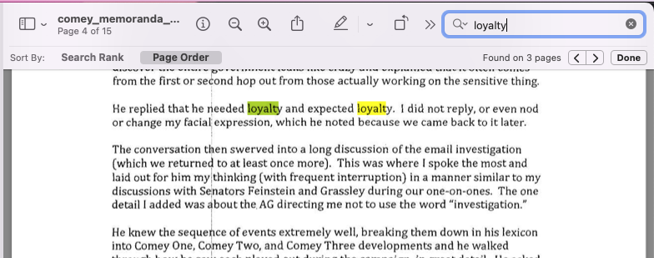
Hands-on: OCRmyPDF
Notes:
Enjoy your lovely searchable pdf

